Slide 1

MINOR PROJECT 1 | NAVIOTECH SOLUTION PVT LTD
Cybersecurity Risk Assessment Framework
A practical, low-cost model for small and medium businesses
Prepared by: Shrish Tyagi
Date: September 2026

Slide 2


Project Overview
Why small businesses need a simple way to measure cyber risk
The problem
Objective 1
SMEs rely on digital tools for sales, communication and record-keeping.
Most have no dedicated IT security team and no formal way to measure risk.
Attackers target SMEs because their defenses are weaker than large firms.
This project builds a framework to find top risks and pick mitigations that fit size and budget.
Develop a model for evaluating cybersecurity risks in SMEs.
Objective 2
Propose mitigation strategies to enhance their security posture.
Cybersecurity Risk Assessment Framework | Shrish Tyagi | September 2026
2

Slide 3







Common Cybersecurity Risks in SMEs
Seven recurring risks form the basis of the assessment model
Phishing
Ransomware
Insider threats
Weak passwords
Fake emails that trick staff into giving up credentials or installing malware
Malware that encrypts business data and demands payment
Malicious or accidental misuse of access by staff or contractors
Easy or reused credentials let one breach escalate
Unpatched software
Unsecured remote access / Wi-Fi
No data backups
Phishing is the most common entry point because it targets people, not technology.
Known vulnerabilities in outdated systems that attackers scan for
Poorly configured networks allow interception or entry
No recovery path turns a minor breach into a business-ending event
Cybersecurity Risk Assessment Framework | Shrish Tyagi | September 2026
3

Slide 4




Risk Assessment Model: NIST CSF
Vendor-neutral, widely recognised, and scales down to teams with no security staff
Identify
Protect
Detect
Respond
Recover
Catalog assets (devices, data, accounts) and the risks that threaten them
Put safeguards in place: access controls and staff training
Notice when something goes wrong, e.g. unusual login activity
Define the steps to take once an incident is confirmed
Restore normal operations, including from backups
Each identified risk is then scored with a simple, repeatable metric so limited budgets go to the highest-priority issues first.
Cybersecurity Risk Assessment Framework | Shrish Tyagi | September 2026
4

Slide 5
Risk Evaluation Metric
Risk Score = Likelihood x Impact (each rated 1 to 5, score range 1 to 25)
High
15 and above
Medium
8 to 14
Low
Below 8
Phishing and ransomware are the top priorities, matching industry reports on the leading causes of SME incidents.
Cybersecurity Risk Assessment Framework | Shrish Tyagi | September 2026
5

Slide 6
Proposed Mitigation Strategies
Ordered roughly by cost-effectiveness for a resource-constrained SME
1
Multi-factor authentication
On email and all critical accounts; counters phishing and weak passwords
5
Encrypted, tested backups
Stored offline or in cloud to survive a ransomware event
2
Security-awareness training
Short, regular sessions on spotting phishing and safe passwords
6
Least-privilege access control
Give staff and contractors only the access their role needs
3
Automated patch management
Timely security updates for operating systems and software
7
Simple incident response plan
One page: who to contact and what to do if a breach is suspected
Endpoint protection and firewalls
Basic antivirus and network firewalls on all devices
Items 1 and 2 (teal) give the best cost-to-benefit ratio
4
Cybersecurity Risk Assessment Framework | Shrish Tyagi | September 2026
6

Slide 7
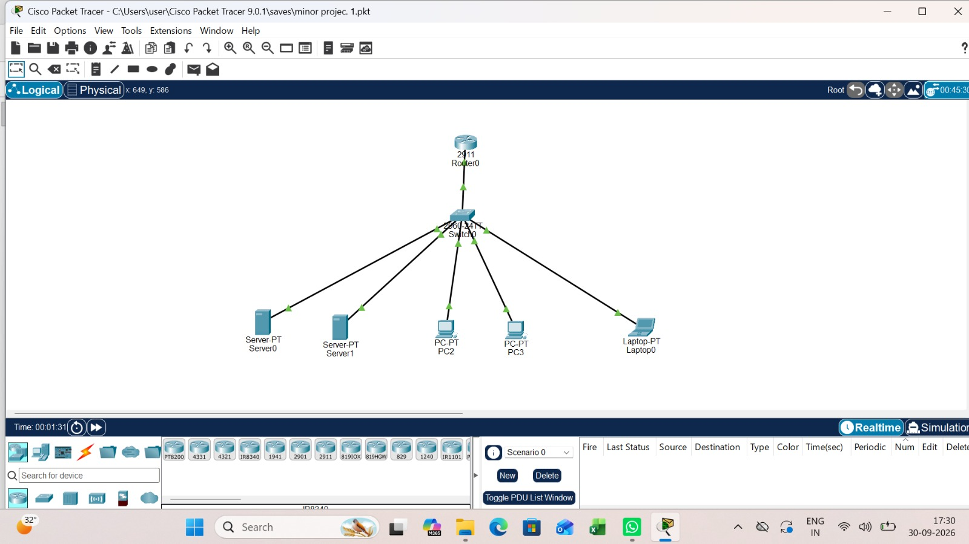
Proof of Work: Packet Tracer Lab
Simulated small-office network built in Cisco Packet Tracer for the project
1
Router (2911)
Gateway to the wider network
1
Switch (2960-24TT)
Central hub for all local devices
2
Servers
Hold business data and services
2
PCs + 1 laptop
Staff endpoints to assess
Star topology: every device links to one switch, which makes it a single point to secure and monitor.
Screenshot: Cisco Packet Tracer 9.0.1, file "minor projec. 1.pkt", 30-09-2026
Cybersecurity Risk Assessment Framework | Shrish Tyagi | September 2026
7

Slide 8



Validation Through Case Studies
The model was applied to three SME profiles with different primary risks
Local retail store
POS system, 5 staff
Small accounting firm
10 staff, client data
E-commerce business
Online store
16
15
12
risk score
risk score
risk score
TOP RISK
TOP RISK
TOP RISK
Phishing targeting the owner's email
Ransomware via unpatched software
Weak / reused admin passwords
RECOMMENDED FIX
RECOMMENDED FIX
RECOMMENDED FIX
MFA on email + basic staff awareness training
Automated patching + offline encrypted backups
Password manager + MFA on all admin accounts
Cybersecurity Risk Assessment Framework | Shrish Tyagi | September 2026
8

Slide 9



Key Findings and Best Practices
Start with MFA and staff training
Highest impact for the lowest cost
KEY FINDINGS
Phishing (16) and ransomware (15) scored highest in every case study.
Insider misuse and lack of training scored lower but compound other incidents.
MFA and staff training gave the best cost-to-benefit ratio.
The same metric worked across three business types while surfacing risks unique to each.
Automate patching and backups
Security should not depend on someone remembering
Reassess every 6 to 12 months
New tools and staff change the risk profile
Keep the incident plan simple
Any employee can follow it under pressure
Cybersecurity Risk Assessment Framework | Shrish Tyagi | September 2026
9

Slide 10

Conclusion
A structured, low-cost framework built on NIST CSF and Likelihood x Impact scoring lets small businesses prioritise cyber risk without a security team.
Case studies show it holds across different SME types, pointing consistently to phishing defenses and access control as the best first investments.
Packet Tracer lab work provided a working network to apply the assessment to.
Future work
Extend the framework into a lightweight self-assessment tool or spreadsheet that SMEs can update on their own.
Thank you | Shrish Tyagi | September 2026

